Slide 1
To configure the username & Mail id in git
git config --global user.name “prem”
git config --global user.email “prem@ibm.com
git init : Initializes a new Git repository in the current folder. Creates a hidden .git directory.
git add . : Adds all modified and new files from workspace to the staging area.
git status : Shows the current state of working directory, staging area, and untracked files.
git commit -m "first commit" : Saves the staged changes into the local repository with a commit message.
git branch -M main : Renames the current branch to 'main' (recommended default branch name).
git remote add origin https://github.com/Pradeephm1998/new_fe.git : Connects your local repository to the remote GitHub repository.
git push -u origin main : Pushes your local 'main' branch to GitHub and sets it as the default upstream branch.
git log : is used to check the repo history.
git log abc.sh : is used to check history of the file.
git log -2 : is used to check last 2-commits
git log -2 abc.sh : Last two commits of the files.

Slide 2
Branches in the Git
Branching:
is a parallel development, two or more teams will work on the same piece of a code on different branches, later they can integrate the changes by merging.

Slide 3
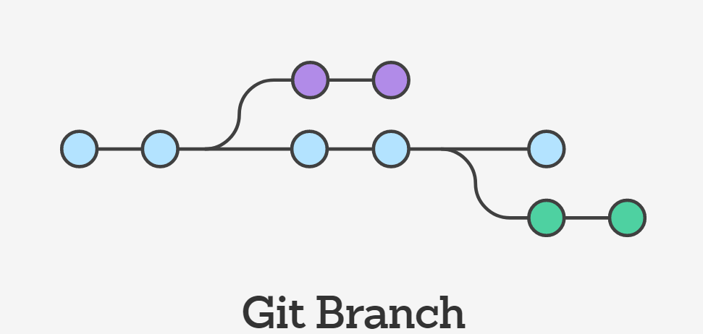
Branching
Branch 1
Master
Branch 2

Slide 4
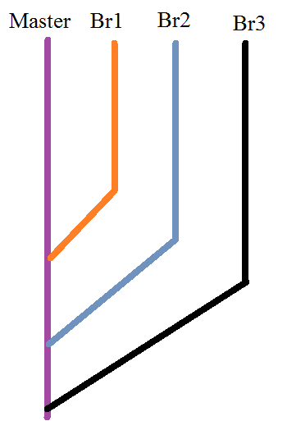

Slide 5
Branches in Git
How to create the branches in git ?????
Git branch new-branch-name
How to switch from one branch to another
Git checkout branch-name
EX: Git checkout Branch1
How to create the branch, and switch to that newly created branch
Git checkout –b new-branch-name
Ex: Git checkout –b Branch2
How to list/check Branches in git
Git branch
* represent, current branch

Slide 6
Git Tag
Tag is the name given to set of versions of files/directories.
It indicates milestone of the project, we can easily remember tags in future.
If I want good code in the future, we tag it by giving a proper name.

Slide 7
Tag
How to create a tag
Git tag tag-name
How to see the list of tags:
  Git Tag
How to move from one tag to another:
  Git checkout tag-name

